Slide 1
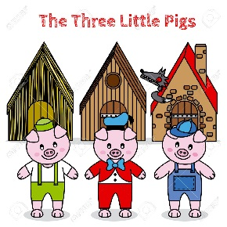
Remember....
Similarities: How the books are alike or the same
Differences: How the books are different or not alike

