Slide 1
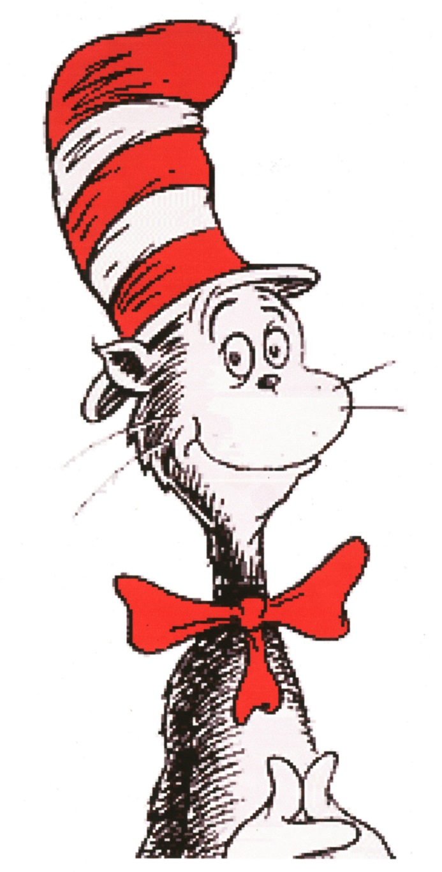
Today we read “The Cat In The Hat” by Dr. Seuss. Here is a list of other words that end in at . All of these words rhyme!

