Slide 1
Schema + Picture = Inference
+ =
By:

Slide 2
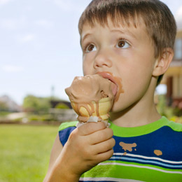
Schema(what we already know) | + | What you see in the picture | = | Inference
It is hot outside in the summer | + | The ice cream is melting The boy is wearing a tank top | = | It is summertime.
This is what YOU already know, not what the picture tells you.
This is ONLY what you see in the picture, not what you think!
This is what you think, or your inference!

Slide 3
Schema(what we already know) | + | What you see in the picture | = | Inference
 | + |  | =

Slide 4
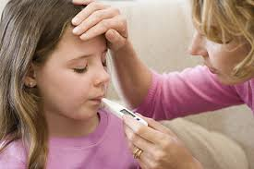
Schema(what we already know) | + | What you see in the picture | = | Inference
 | + |  | =

Slide 5
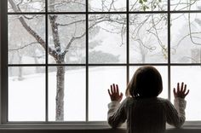
Schema(what we already know) | + | What you see in the picture | = | Inference
 | + |  | =

