Slide 1
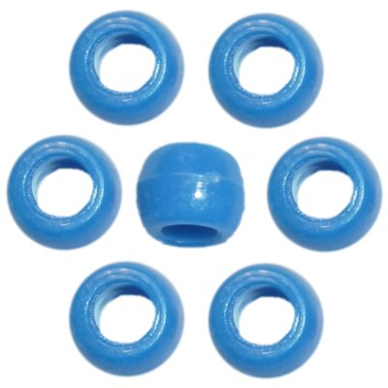
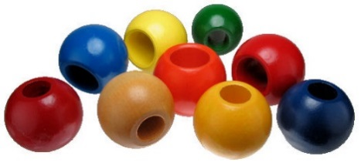
Use the unifix cubes and beads to measure these computer parts:
Computer Part | How many unifix cubes? | How many beads?
the mouse pad
the space bar
the enter key
the monitor
the keyboard
Name:

Slide 2
Type one of these words to make each sentence true. shorter, equal, longer
The mouse pad is than the keyboard.
The monitor is than the keyboard.
The keyboard is than spacebar.
The enter key is than the mouse pad.
The spacebar is than the monitor.

Slide 3
Which part of the computer is the shortest?

Slide 4
Which part of the computer is the longest?

